Slide 1
Animal Classification using Scikit-learn

Slide 2
Animal Classification
Objective
Create a machine learning application to detect different animals
Specifications
Use Scikit-learn (Sklearn) to generate a ML model using Support Vector Machines through training the dataset.
Use the ML model to detect animals from the test dataset.

Slide 3
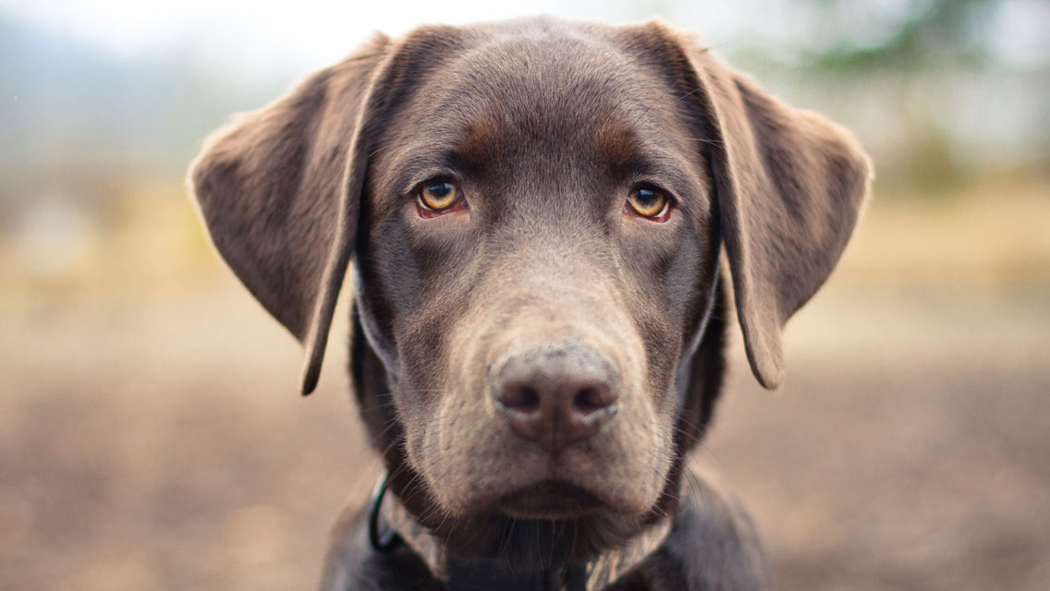
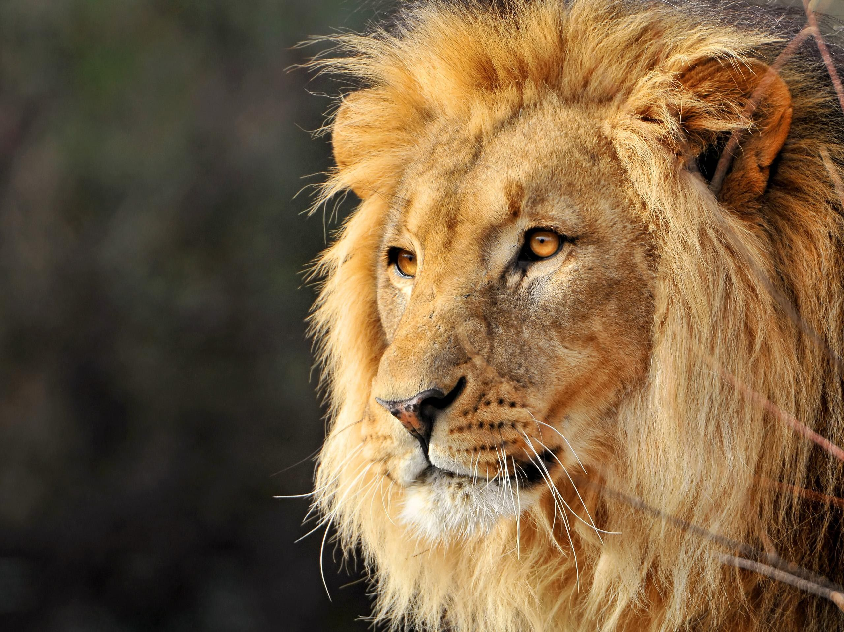
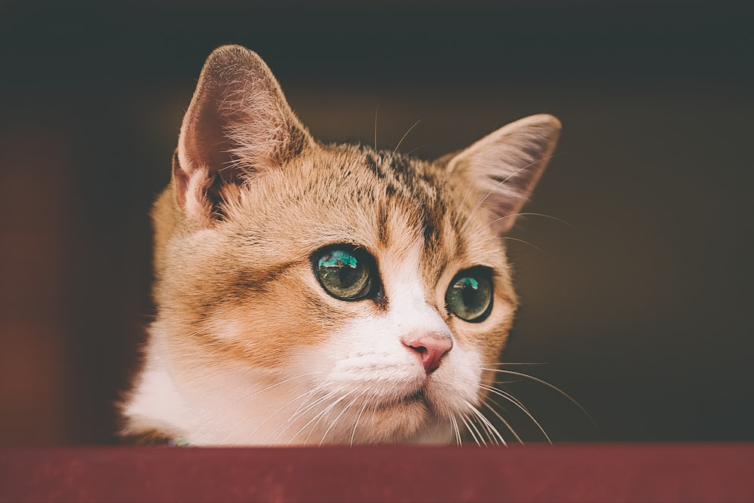
Animal Classification
Dataset: 5 Mammals
Utilizes data from 5 Mammals databases collected by user Shiv28
15,000 animal images belonging to 5 categories: Dog, Cat, Horse, Elephant, Lion
We will only use Dogs, Lions and Cats with 800 images each for training and ~200 images each for testing.
Link to dataset: https://www.kaggle.com/datasets/shiv28/animal-5-mammal

Slide 4
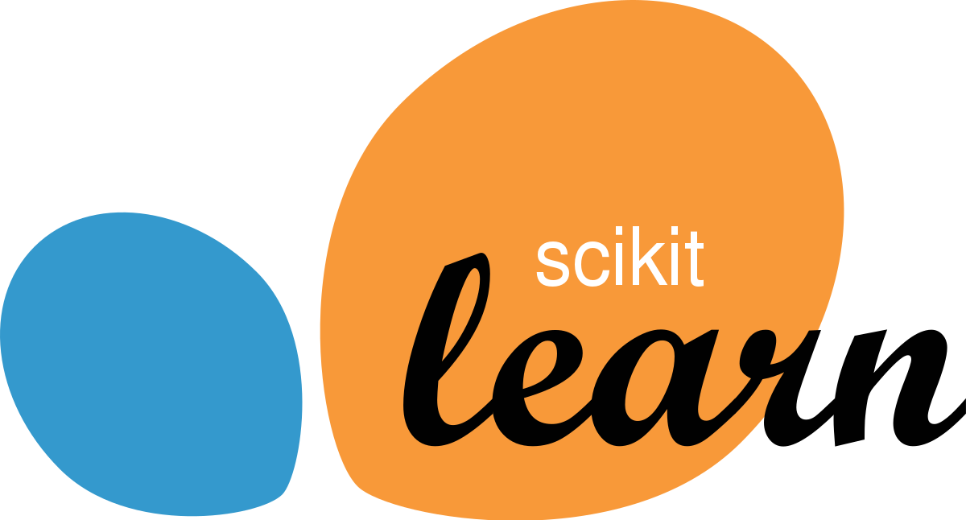
Scikit-learn (Sklearn)
Popular open-source ML library for Python
Used for different ML and Image Processing Tasks
Image Classification
Image Segmentation
Feature extraction
Supports various supervised learning algorithms
Support Vector Machines (SVM)
Decision Trees
Random Forests
K-Nearest Neighbors

Slide 5
Support Vector Machines (SVM)
Popular ML algorithm used for classification and regression.
Creates a decision hyperplane that separates data features of different classes as further as possible.
Maximizes the boundary between decision surfaces and the nearest data-points of each class.
Support vectors are referred to as the closest data points to the decision surfaces.

Slide 6
Support Vector Machines (SVM)
SVM Trains by taking an input set of the training dataset
The dataset contains support vectors and their respective class labels
SVM uses the kernel to transform the original feature into a higher-dimensional feature space for training.
Such transformation helps SVM to find a non-linear decision boundary for multiclass classification.
When a support vector is identified, SVM starts to train the data.

Slide 7
Programming Task
Implement a trained model using SVM to classify cats, dogs and lions from the supplied dataset.
Use Jupyter Notebook to write a script to differentiate the large dataset into training and validation datasets.
Generate the training model using the training dataset through SVM
Use the pickle library to save the training model.
Use the model to test the testing dataset.
Display the accuracy of the model and the classified images.

Slide 8
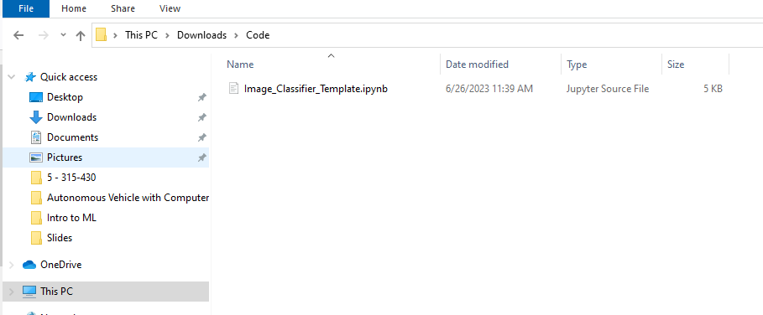
Jupyter Notebook
Locate the Image_classifier_template.ipynb file

Slide 9
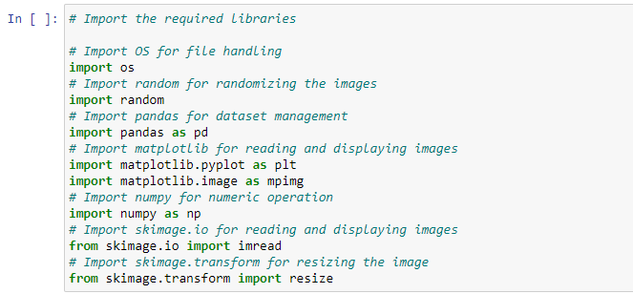
Code
Fill the template with the codes denoted by arrows
Run each cells after completing the code

Slide 10
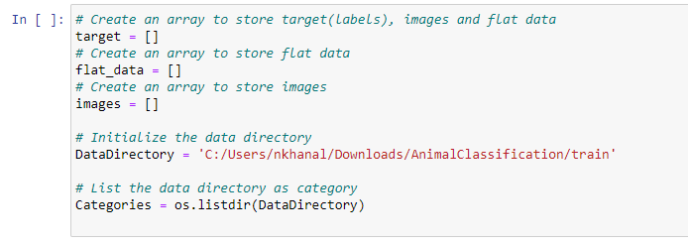
Code

Slide 11
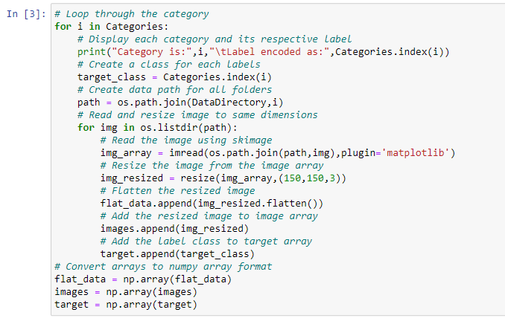
Code

Slide 12
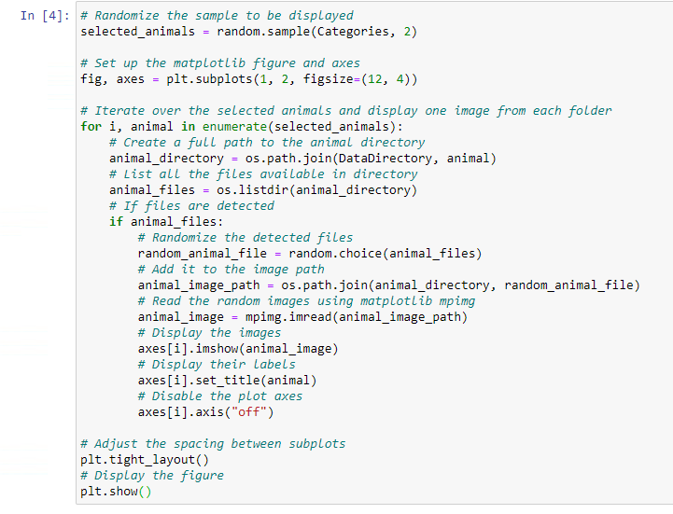
Code

Slide 13

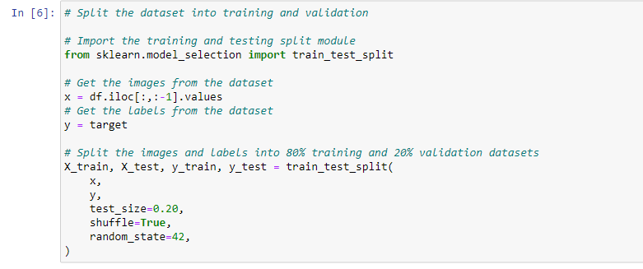
Code

Slide 14
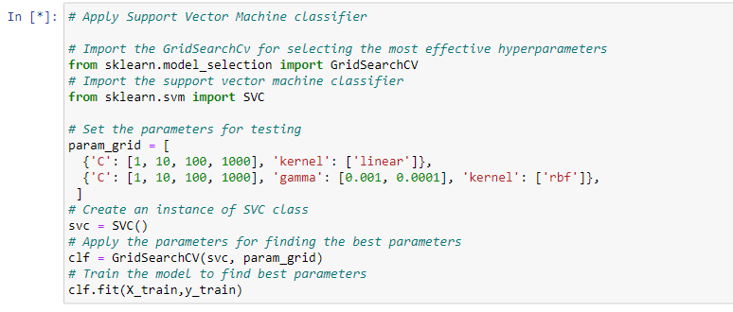
Code

Slide 15
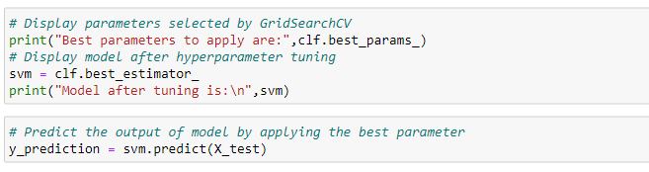

Code

Slide 16
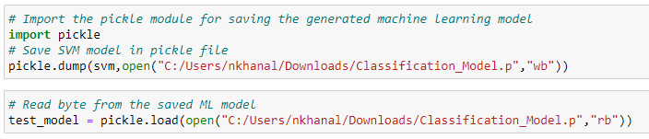
Code

Slide 17
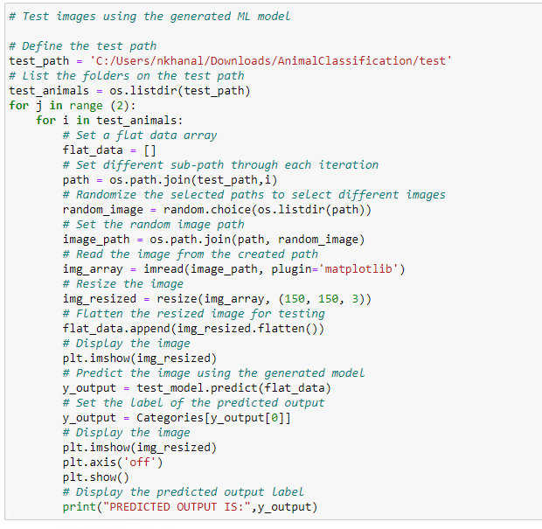
Code

Slide 18
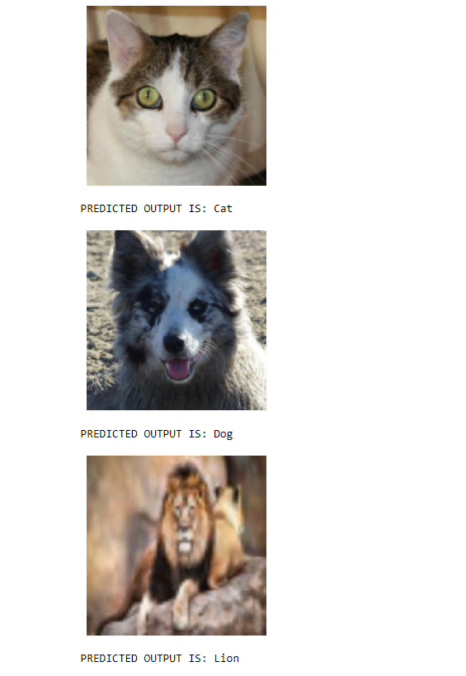
Output

Slide 19
DISCUSSION
Discuss the following questions with your neighbor
Which animals were identified the most reliably?
How could we improve this if we ran it again?
Why are the predictions not perfectly accurate?

